Slide 1
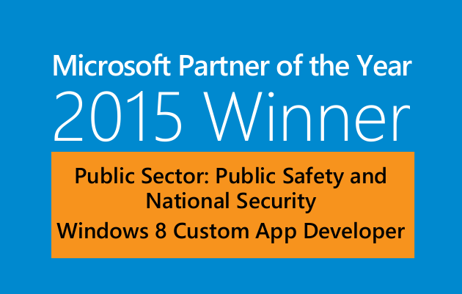
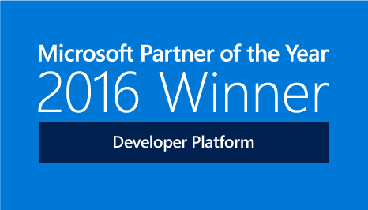

Living the dream
Real world DevOps with Azure and VSTS
Richard Fennell
@richardfennell

Slide 2

Evolving DevOps
Trends we see
Notes:
DevOps is no longer just a niche, it is now mainstream
As DevOps practices continue to mature and more teams embrace it, it is evolving
Here are some trends that we see

Slide 3
“High-performing organizations are decisively outperforming their lower-performing peers in terms of throughput. High performers deploy 200 times more frequently than low performers, with 2,555 times faster lead times.”
Source: Puppet Labs, State of DevOps Report, 2016
Notes:
Why is DevOps so important for success?
The State of DevOps report distinguishes high- from medium- and low-performing organizations.
It found that high performers …
Deploy 200x more frequently than low performers, with 2,555x faster lead times, 24x faster recovery times and 3x lower change failure rates
Have better morale. Employees in high-performing organizations were 2.2 times more likely to recommend their organization as a great place to work
Spend 22 percent less time on unplanned work and rework.
As a result …
They are able to spend 29 percent more time on new work, such as new features or code
Experiment in product development, by working in small batches; providing visibility into the flow of work; and gathering customer feedback to iterate

Slide 4
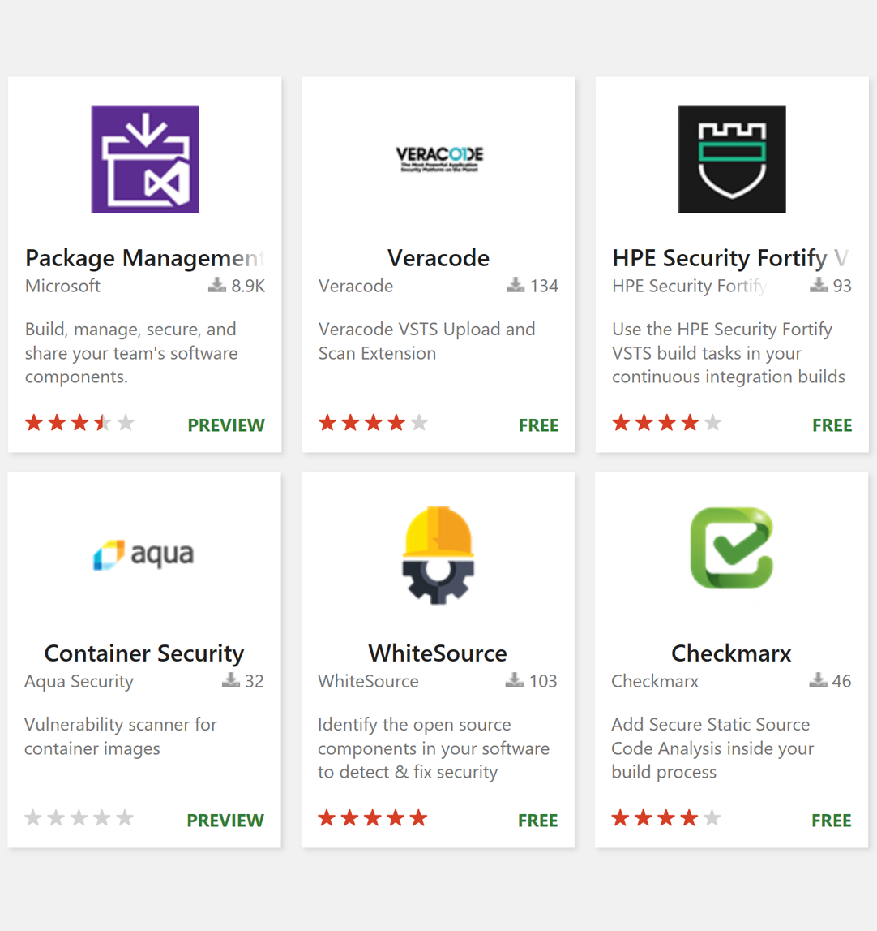
DevOps and Security
DevOps + automated security & compliance = Rugged DevOps
Notes:
One of the topics I want to specifically highlight here is security
DevOps is all about moving security and compliance scanning closer to the developer
Automating techniques like static and dynamic analysis and open source scanning are becoming integral to DevOps
We have great integrations with leaders in the security space:
Checkmarx:
The Checkmarx’ s extension for VSTS allows developers to run static analysis security scans on all source code. With Checkmarx, this works not only across the full code base, but also for just the changes. You make a pull request of 10 lines and can find out if the new code introduces any new vulnerability, and you can find out fast. This incremental scanning capability is a key enabler for developers in CI environments as it reduces scan times from hours to only a few minutes. Once the analysis is complete, Checkmarx delivers a concise report detailing the security posture of the scanned code on the VSTS project summary page, which allows developers to address and mitigate the vulnerabilities. Checkmarx also provides developers with the “Best Fix Location” in order to minimize the time to remediate. This includes a visual chart of the data flow graph that indicates the ideal location in the code to address multiple vulnerabilities within the data flow in a single line of code. With rule customization, development teams also can modify the existing vulnerability detection preset queries to enhance detection and accuracy. Checkmarx describes the rules in a simple C# syntax. https://www.checkmarx.com/technology/static-code-analysis-sca/
Whitesource:
The Whitesource extension for VSTS automatically identiﬁes all the open source components and dependencies in your build by constant and automatic cross-referencing of your open source components against WhiteSource’s deﬁnitive database of open source repositories. http://www.whitesourcesoftware.com/what-is-whitesource/
Veracode:
With this integration from Veracode, developers can statically scan an application’s first party and third party code and receive results without additional manual effort from the developer. Teams can choose to use the low-noise results of the Veracode scan to automatically stop the build or release pipeline if a vulnerability violates the company’s policy. Teams can also optionally scan their application in a Developer Sandbox so that they can preview the results and fix them before the results are reported as part of the organization’s overall policy assessment. The combined solution offers fewer disruptions for developers through integrated testing within the development lifecycle - thereby reducing friction between security and development teams. By shifting security testing left in the development process, developers can increase the speed of secure software delivery while achieved compliance requirements of customers and regulators, enabling teams to realize the full potential of DevOps. http://www.veracode.com/products/binary-static-analysis-sast

Slide 5
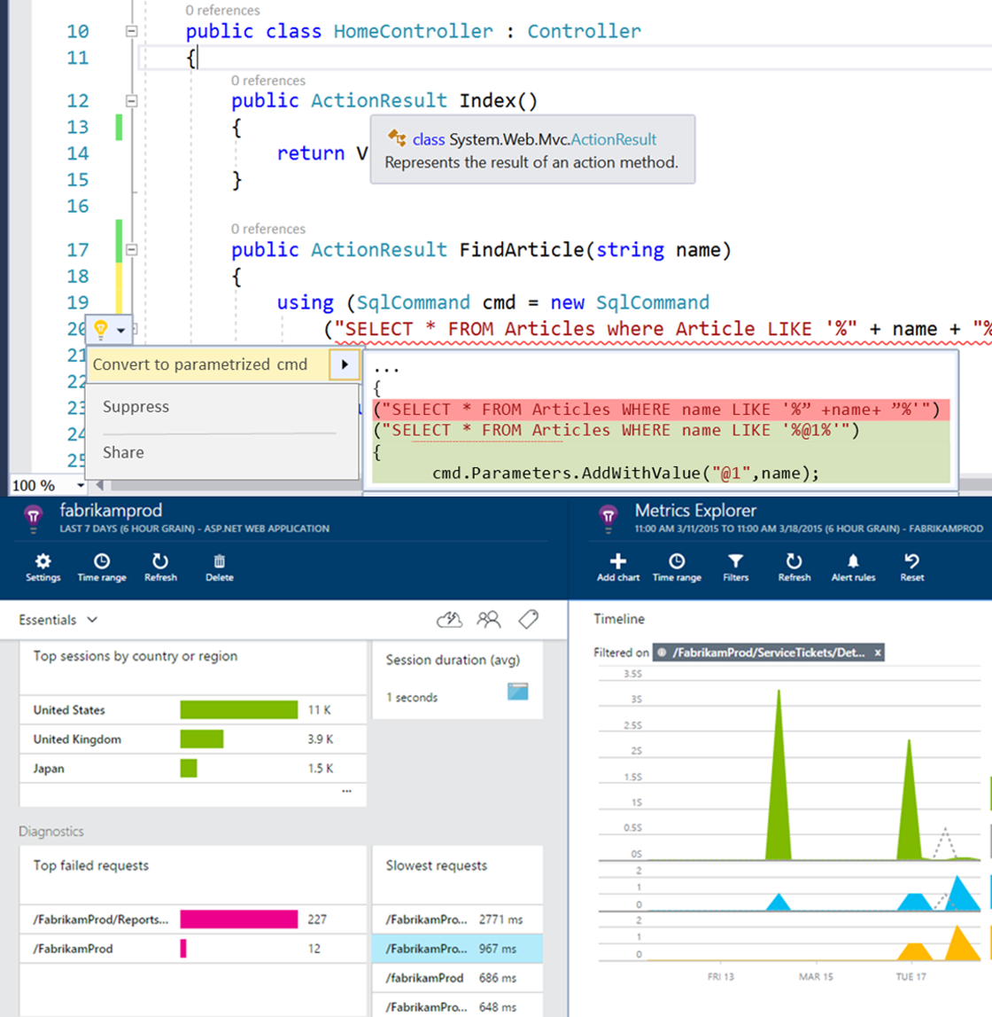
Evolving DevOps
Continuous Integration + Real-time experiences = Shift Left
Continuous data mining + near real-time data = Shift Right
Notes:
Shift left
If the fundamental promise of DevOps is to lower cycle time, then one area where you will get the most benefit is by speeding up the developer’s inner loop
This means moving testing closer to the developer – this is referred to as Shifting Left
The software development process has been shifting left due to the growing challenge of developing and delivering software releases faster and faster
This is what shifting left is all about - uncovering as many issues as possible as early as you can in the software development process, to decrease the cost of fixing them later and improve the quality of the shipped product
One big investment for Visual Studio 2017 are real-time experiences in the IDE
As you write code in the editor, real time features alert you to things like broken unit tests or violations as you type
Shift right
Building quality from the very beginning is not enough. Getting continuous feedback from users is equally significant in the testing process. Just as important is te ability to monitor in production and collect data that then yields actionable insights. This is the shift-right process
Practices like testing in production, experimentation/a-b testing and user telemetry collection are all shift-right practices

Slide 6
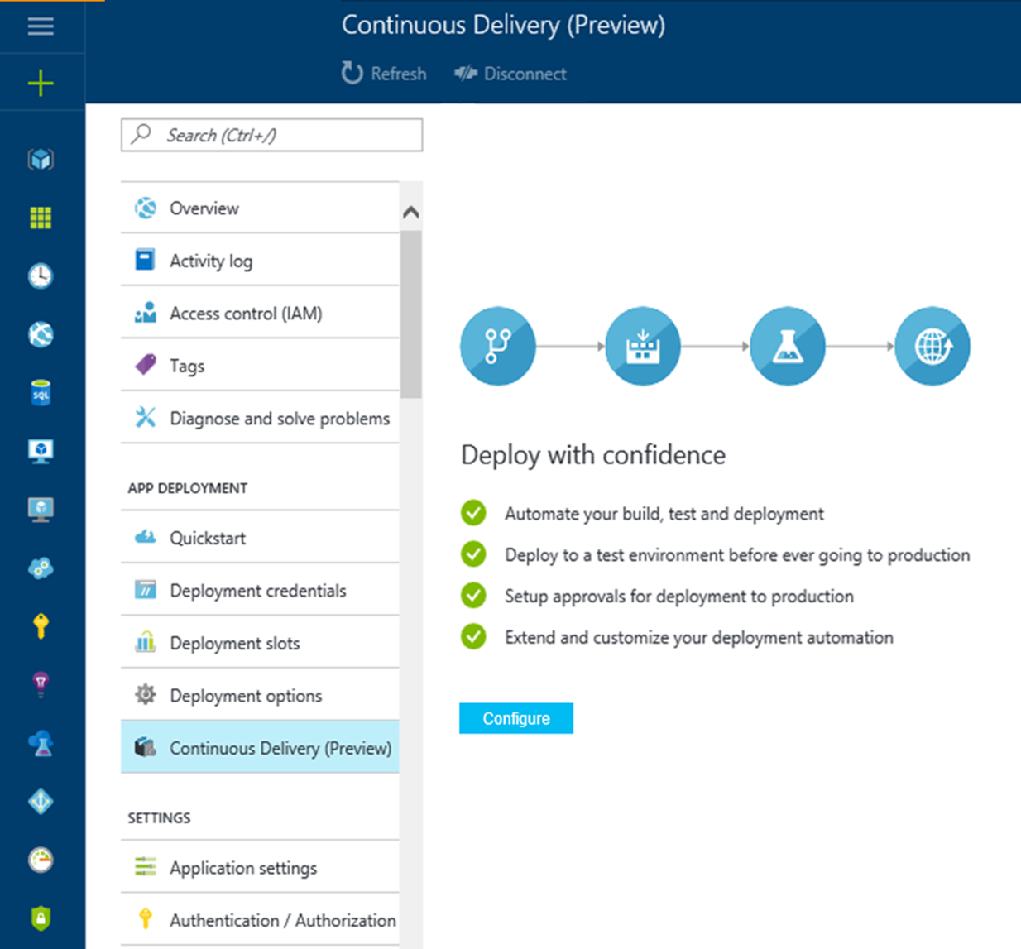
DevOps enables Cloud
Cloud-optimized DevOps tools: DevOps practices = Continuous Delivery to the Cloud
Notes:
DevOps practices are key to cloud adoption
For most organizations, moving to the cloud is a daunting task
Today’s modern release pipelines target Cloud by default
This enables any organization to deploy to the cloud continuously thereby unlocking the fundamental benefits of DevOps - for example scaling on demand and paying only for what you really use

Slide 7
DevOps for any app, any code, any platform
Shift left to speed up value delivery
DevOps gets you to the Cloud faster
Notes:
To summarize, here are the key things I would like you to take away from this session
We have a truly first-class Java DevOps offering and our solution works with any app, any code and any platform
To reduce cycle time and deliver software faster, more and more testing is shifting left into the developer’s Inner Loop
A cloud-optimized delivery pipeline will help you adopt the Cloud faster and unlock its unique benefits

Slide 8



The first way (systems thinking)
DEV
OPS
Notes:
The First Way emphasizes the performance of the entire system, as opposed to the performance of a specific silo of work or department - this can be as large as a division (e.g., Development or IT Operations) or as small as an individual contributor (e.g., a developer, system administrator).
It begins when requirements are identified (e.g., by the business or IT), are built in Development, and then transitioned into IT Operations, where the value is delivered to the customer.
When we think as a system, we can focus clearly on the business value that flows between business, dev, ops, and end users.
The outcomes of putting the First Way into practice include never passing a known defect to downstream work centers, never allowing local optimization to create global degradation, always seeking to increase flow, and always seeking to achieve profound understanding of the whole system.

Slide 9

The second way (feedback loops)
DEV
OPS
Notes:
The Second Way is about creating right to left feedback loops.
The goal of almost any process improvement initiative is to shorten feedback loops so necessary corrections can be made quickly and continuously.
The outcomes of the Second Way include understanding and responding to all customers, internal and external, shortening and amplifying all feedback loops, and embedding knowledge where we need it.

Slide 10

The third way (experimentation)
DEV
OPS
Notes:
The Third Way is about creating a culture that fosters two things: continual experimentation, taking risks and learning from failure; and understanding that repetition and practice is the prerequisite to mastery.
Experimentation and taking risks are what ensures that we keep pushing to improve, even if it means going deeper into the danger zone than we’ve ever gone.
And we need mastery of the skills that can help us retreat out of the danger zone when we’ve gone too far.
The outcomes of the Third Way include allocating time for the improvement of daily work, creating rituals that reward the team for taking risks, and introducing faults into the system to increase resilience.

Slide 11




Contrasting ALM and DevOps
DEV
OPS
Notes:
Application lifecycle management is the product lifecycle management (governance, development, and maintenance) of software.
ALM describes how all roles in a software development project are in sync with each other throughout all application development stages.
Microsoft has been delivering solutions for teams to improve agility in the Application Lifecycle for more than 10 years by helping development & test teams collaborate better and deliver value more quickly.
Such integration ensures that every team member knows Who, What, When, and Why of any change made during the development process and that there is no last minute surprise causing delivery delays or project failure.
With development and test teams delivering value faster, we now want to focus on helping Ops release more efficiently and reliably.

Slide 12

A converged lifecycle
Agile Planning
Dashboards
Kanban Boards
Taskboards
Monitor
ApplicationInsightsHockeyApp
Monitor + Learn
Plan + Track
DevOps
DevOps for Java
Jamie Cool
Build and Test
IntelliJ
Git Source Control
Modern Code Workflow
Continuous Integration
Technical Debt Management
Security Scanning
Open Source Compliance
Release
Release
Docker Deployment
Functional Testing
Azure Container Service
Develop + Test

Slide 13
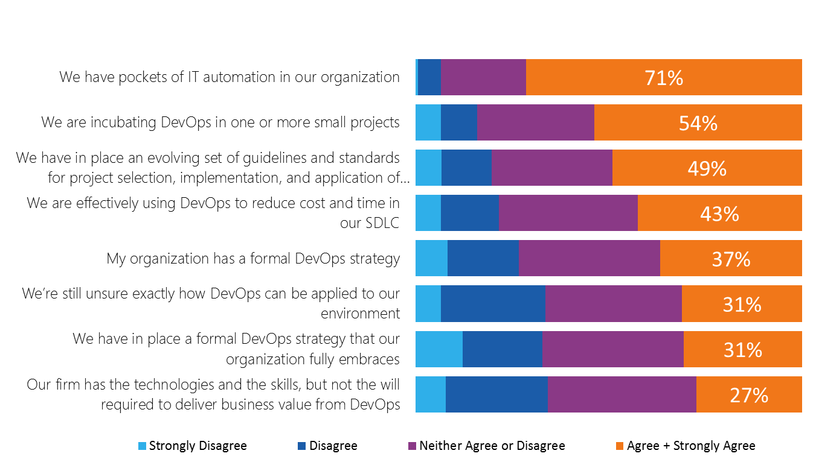
DevOps adoption
Source: Saugatuck Technology Inc. © 2014 www.saugatucktechnology.com
Notes:
Analyst studies show high interest but also confusion when it comes to DevOps implementation.
Though in the early stages, DevOps is clearly considered to be a beneficial approach worthy of standardizing and formalizing.
The data continues to indicate very strongly that a provider with an integrative DevOps platform, likely combined with guidance/professional services assisting in coalescing disparate instances, standards, and practices, would be welcomed.

Slide 14
Azure Resource Templates

Slide 15
Templates are Azure’s Infrastructure as Code
They are declarative
They are idempotent
They allow deployment of complex resources
They can be nested (call other templates)
You can do clever stuff with sequencing
They are part of a healthy balanced DevOps diet

Slide 16
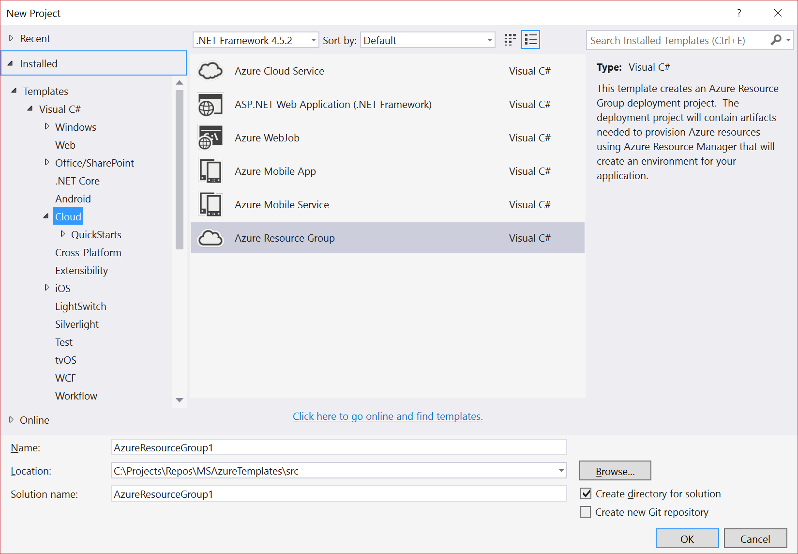
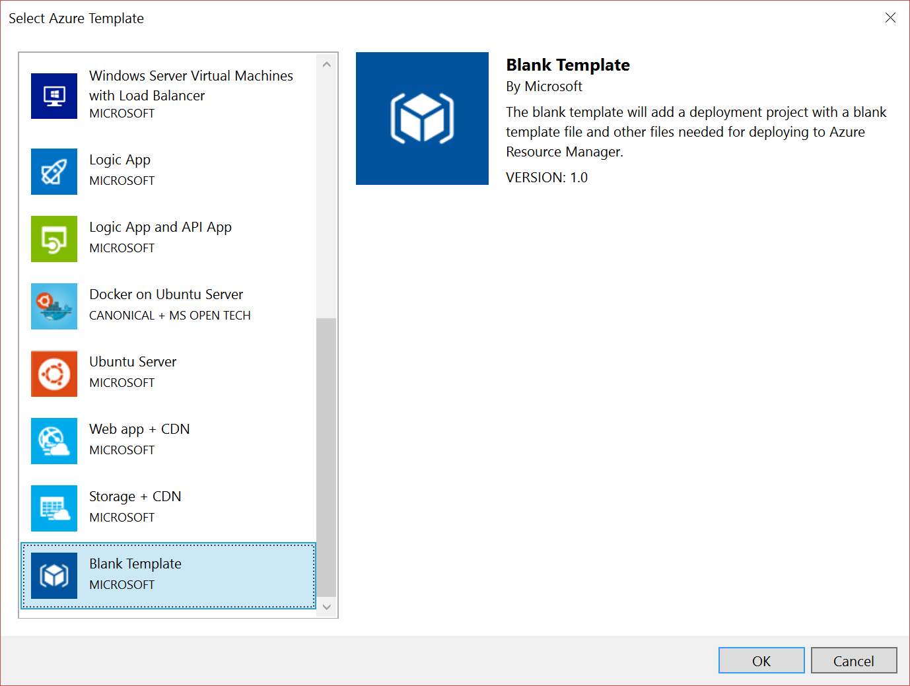
Create and edit them in Visual Studio
Yes, you can use Visual Studio Code, but the Azure SDK tooling is better in VS

Slide 17
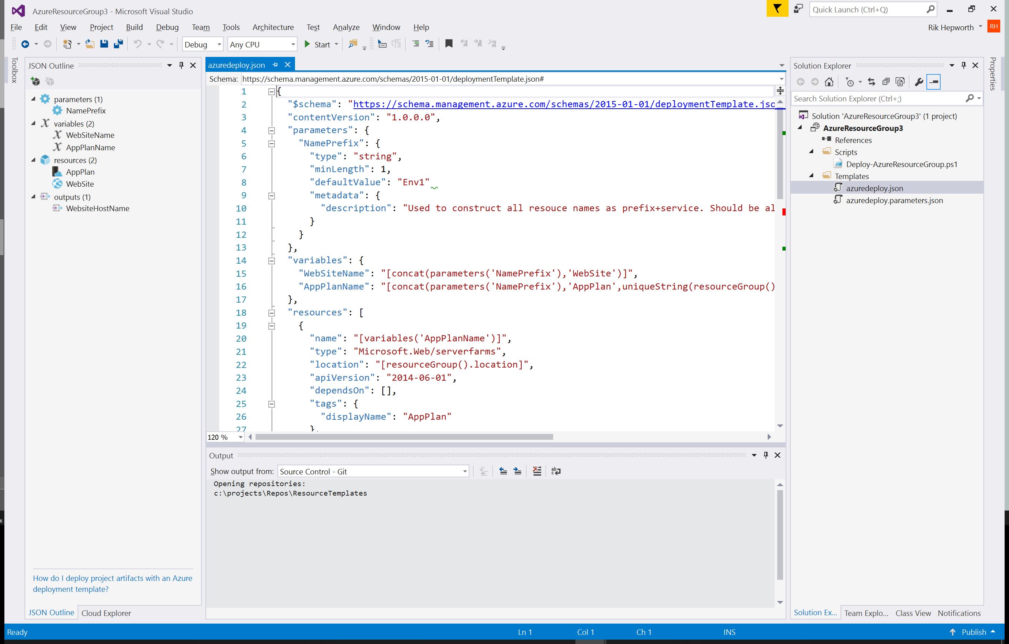
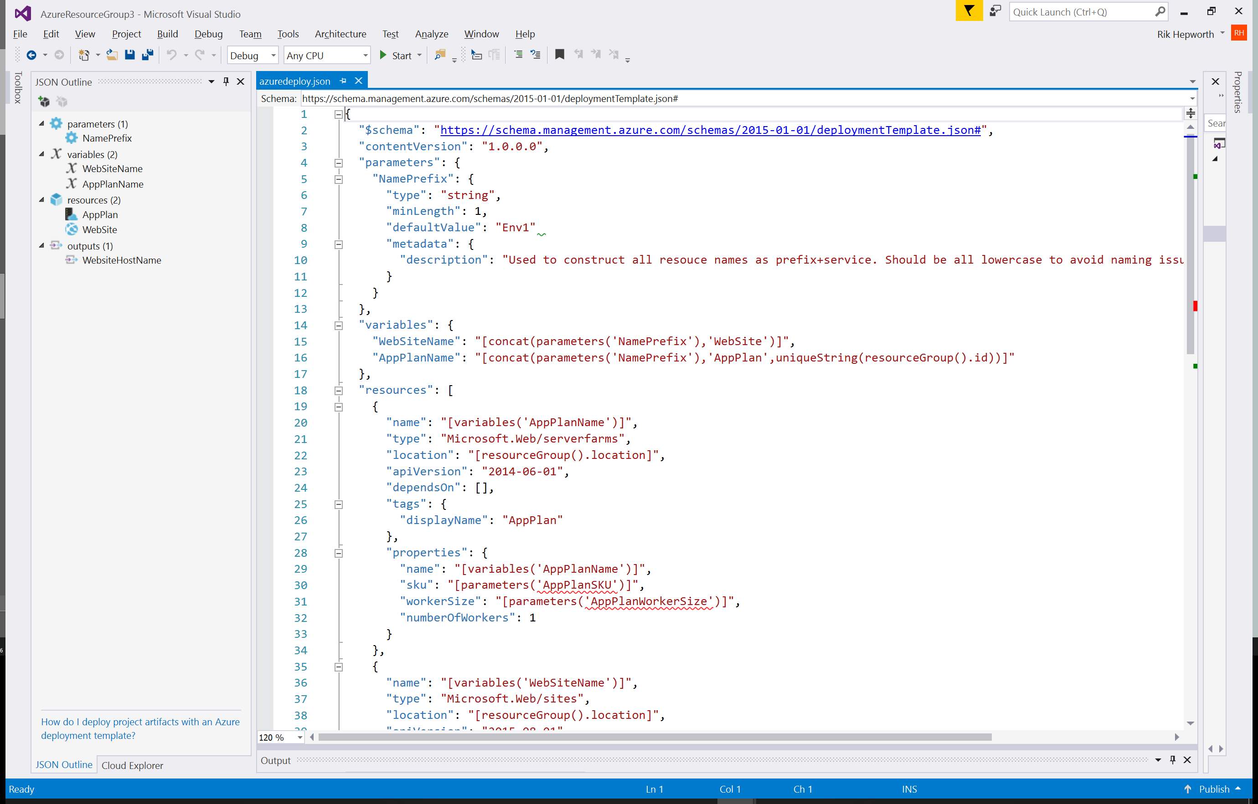
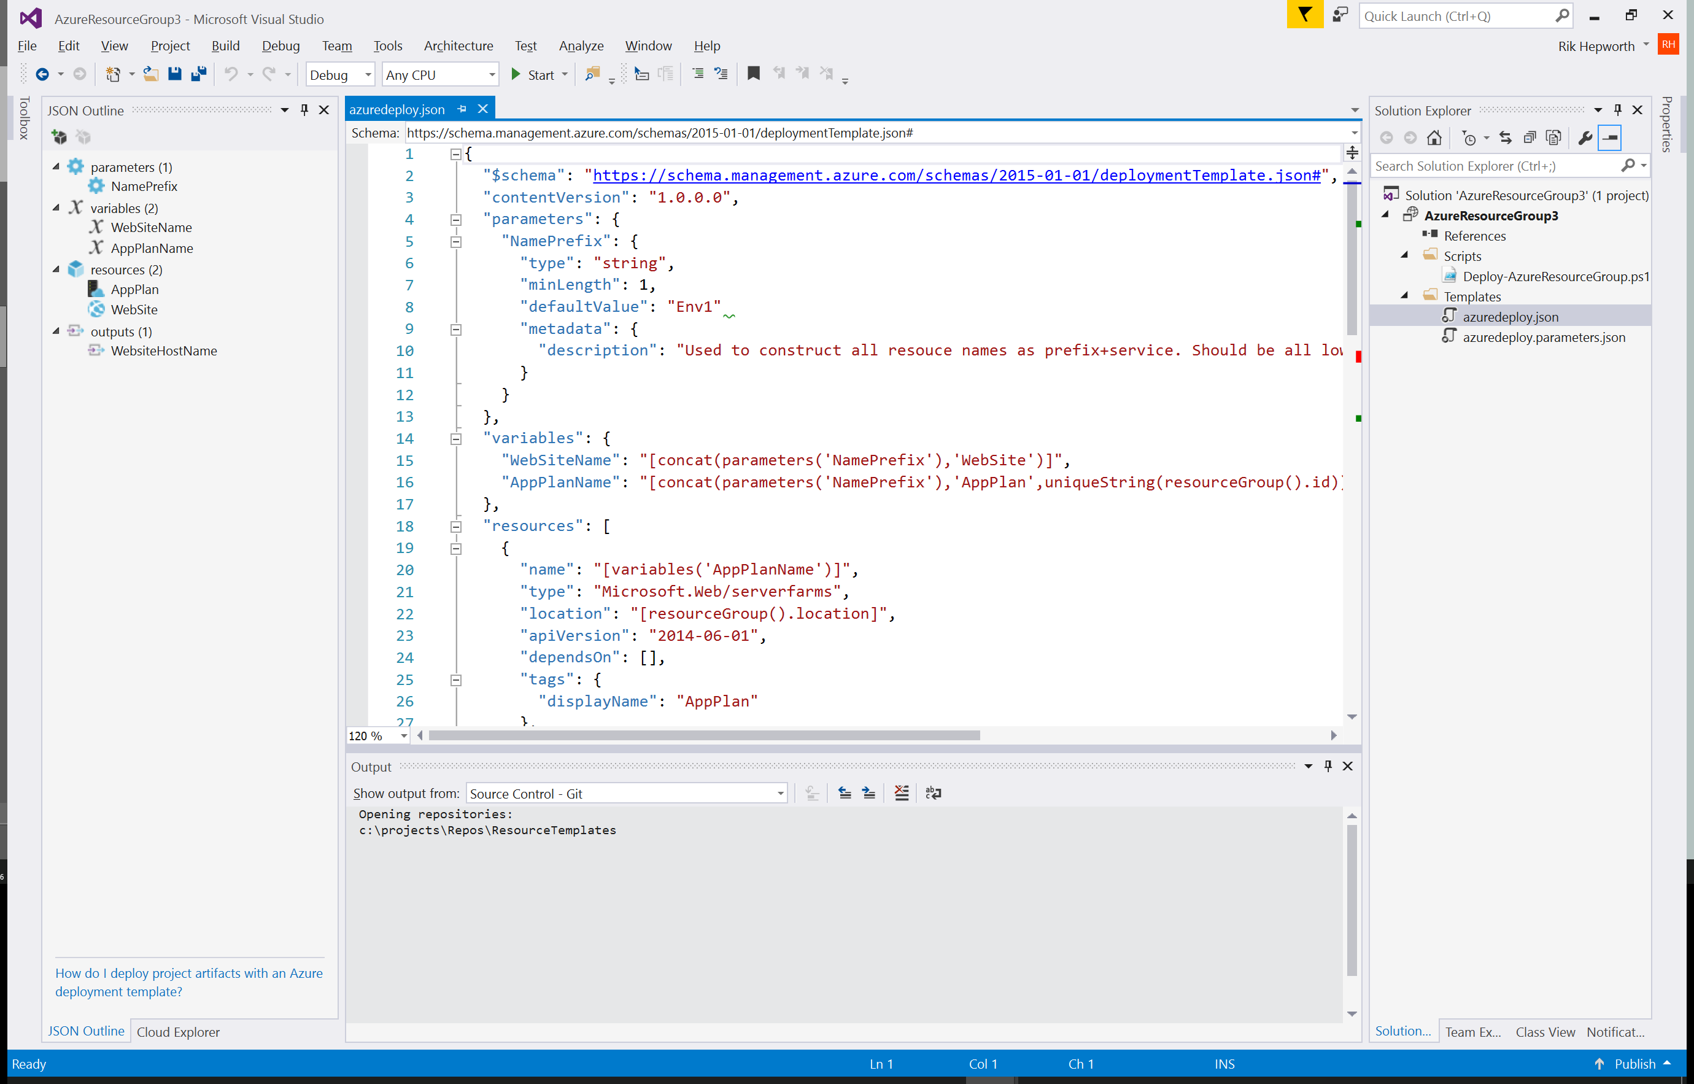
Templates are JSON format
And have four sections, easily manged in the JSON outline pane

Slide 18
Resources are the things you want to deploy
"resources": [
{
"name": "[variables('AppPlanName')]",
"type": "Microsoft.Web/serverfarms",
"location": "[resourceGroup().location]",
"apiVersion": "2014-06-01",
"dependsOn": [],
"tags": {
"displayName": "AppPlan"
},
"properties": {
"name": "[variables('AppPlanName')]",
"sku": "[parameters('AppPlanSKU')]",
"workerSize": "[parameters('AppPlanWorkerSize')]",
"numberOfWorkers": 1
}
}
]

Slide 19
Parameters allow deploy-time settings
"parameters": {
"NamePrefix": {
"type": "string",
"minLength": 1,
"defaultValue": "Env1"
"metadata": {
"description": "Used to construct all resource names as prefix+service. Should be all lowercase to avoid naming issues"
}
}
}

Slide 20
Variables are really, really useful
"variables": {
"WebSiteName": "[concat(parameters('NamePrefix'),'WebSite')]",
"AppPlanName": "[concat(parameters('NamePrefix'),'AppPlan',uniqueString(resourceGroup().id))]",
"RedisCache": {
"Name": "[concat(parameters('NamePrefix'),'Redis',uniqueString(resourceGroup().id))]",
"SKUName": "Basic",
"SKUFamily": "C",
"SKUCapacity": 0
}
}

Slide 21
Outputs let you return values
"outputs": {
"WebsiteHostName": {
"value": "[reference(resourceId('Microsoft.Web/sites',variables('WebSiteName'))).hostNames[0]]",
"type": "string"
}
}

Slide 22
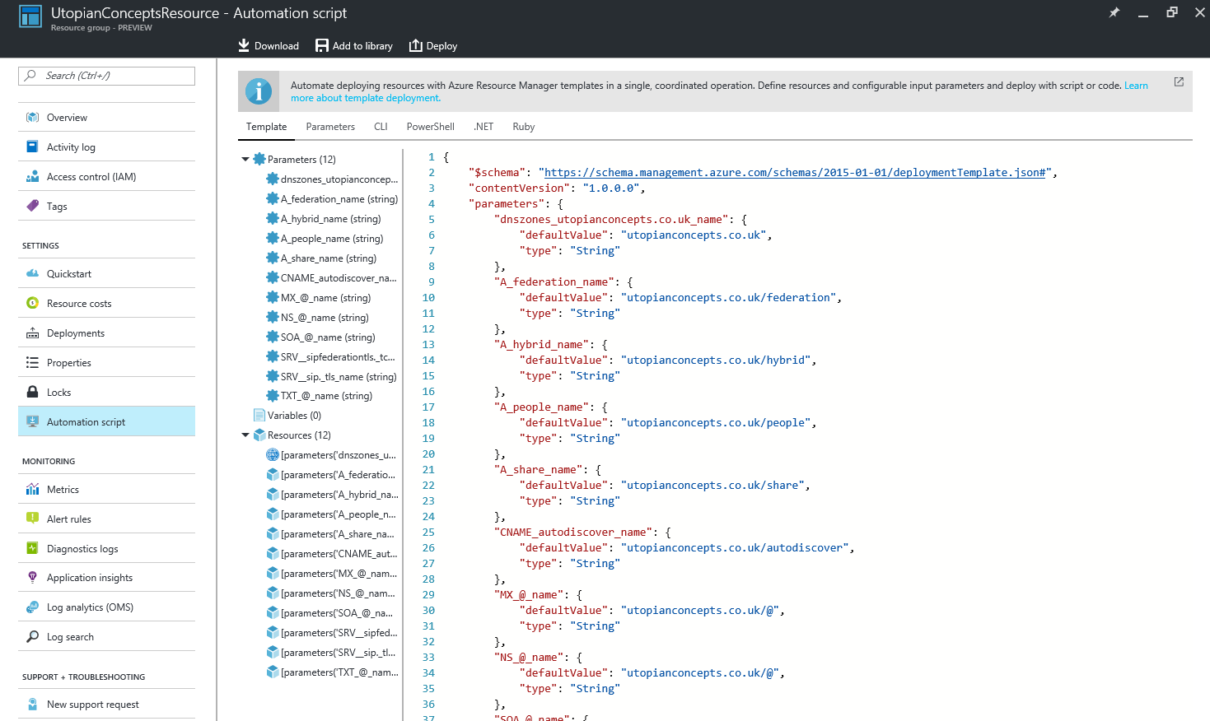
Export your existing stuff as a template

Slide 23
Build and Release Automation

Slide 24
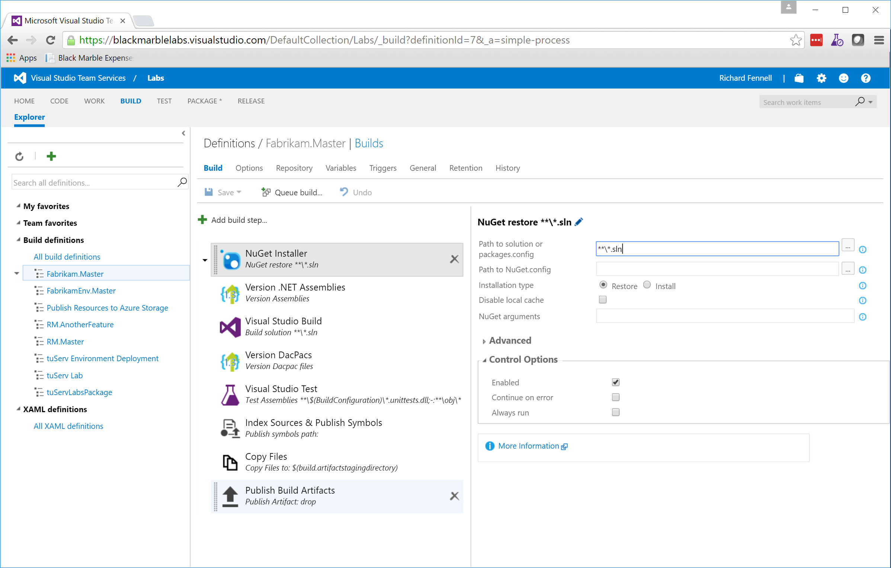
VSTS’s Build System

Slide 25
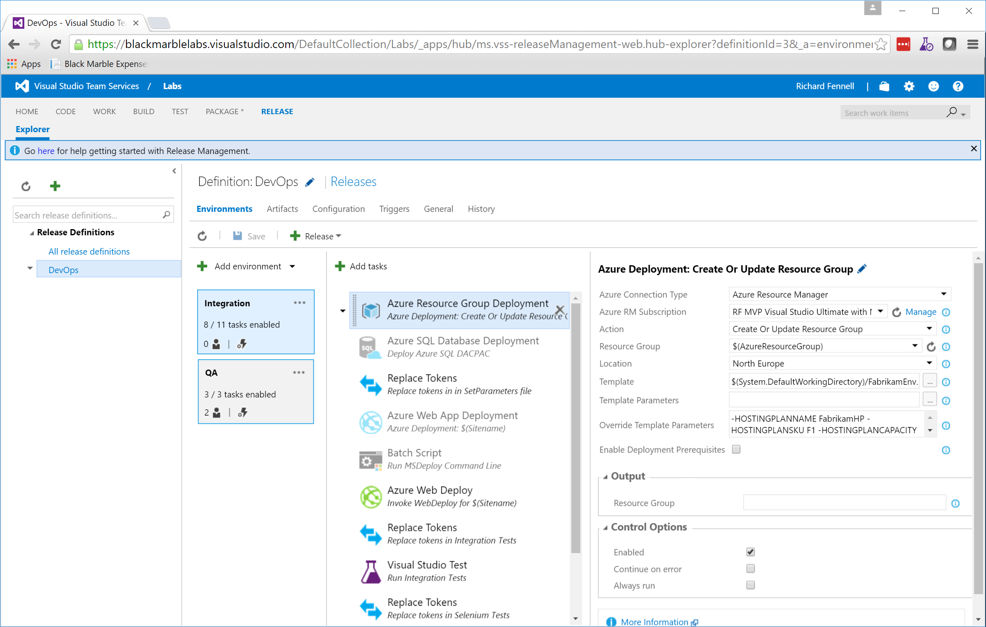
VSTS’s Release System

Slide 26
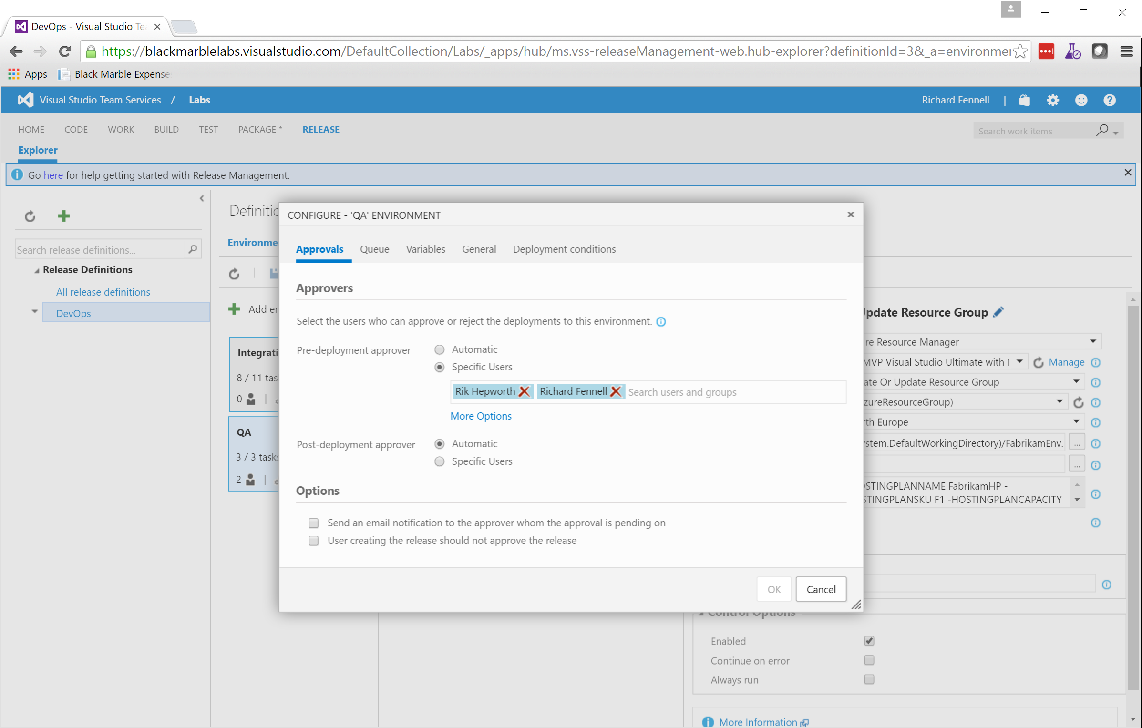
VSTS’s Release System - Approval

Slide 27
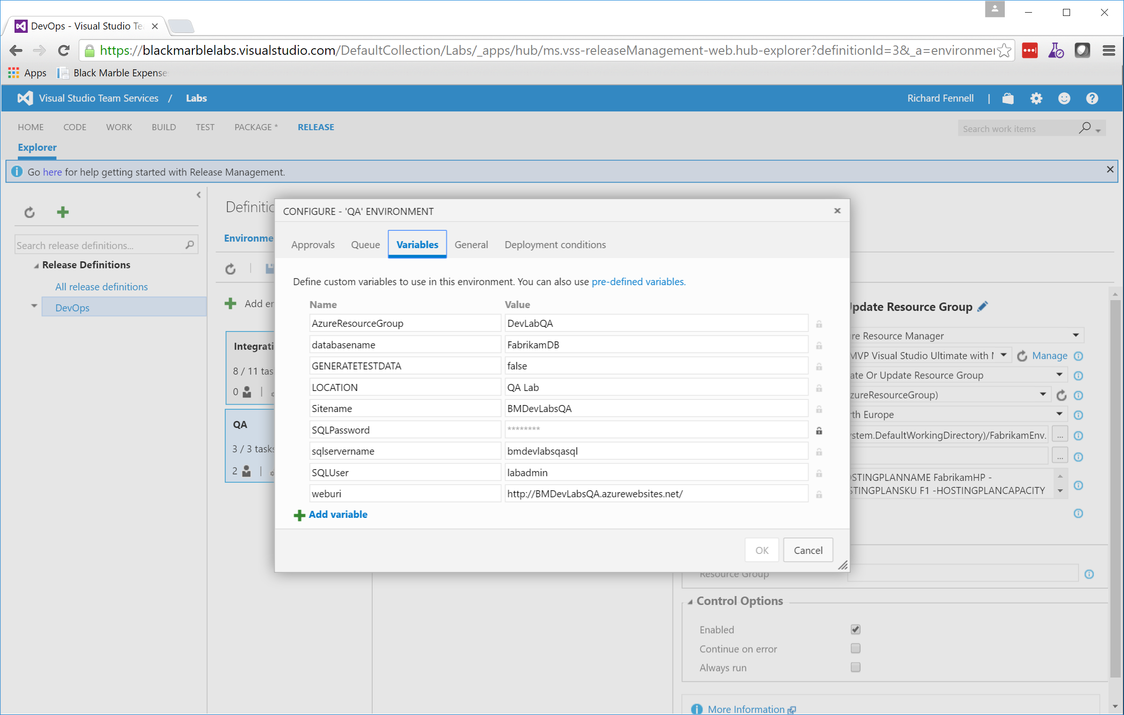
VSTS’s Release System - Variables

Slide 28
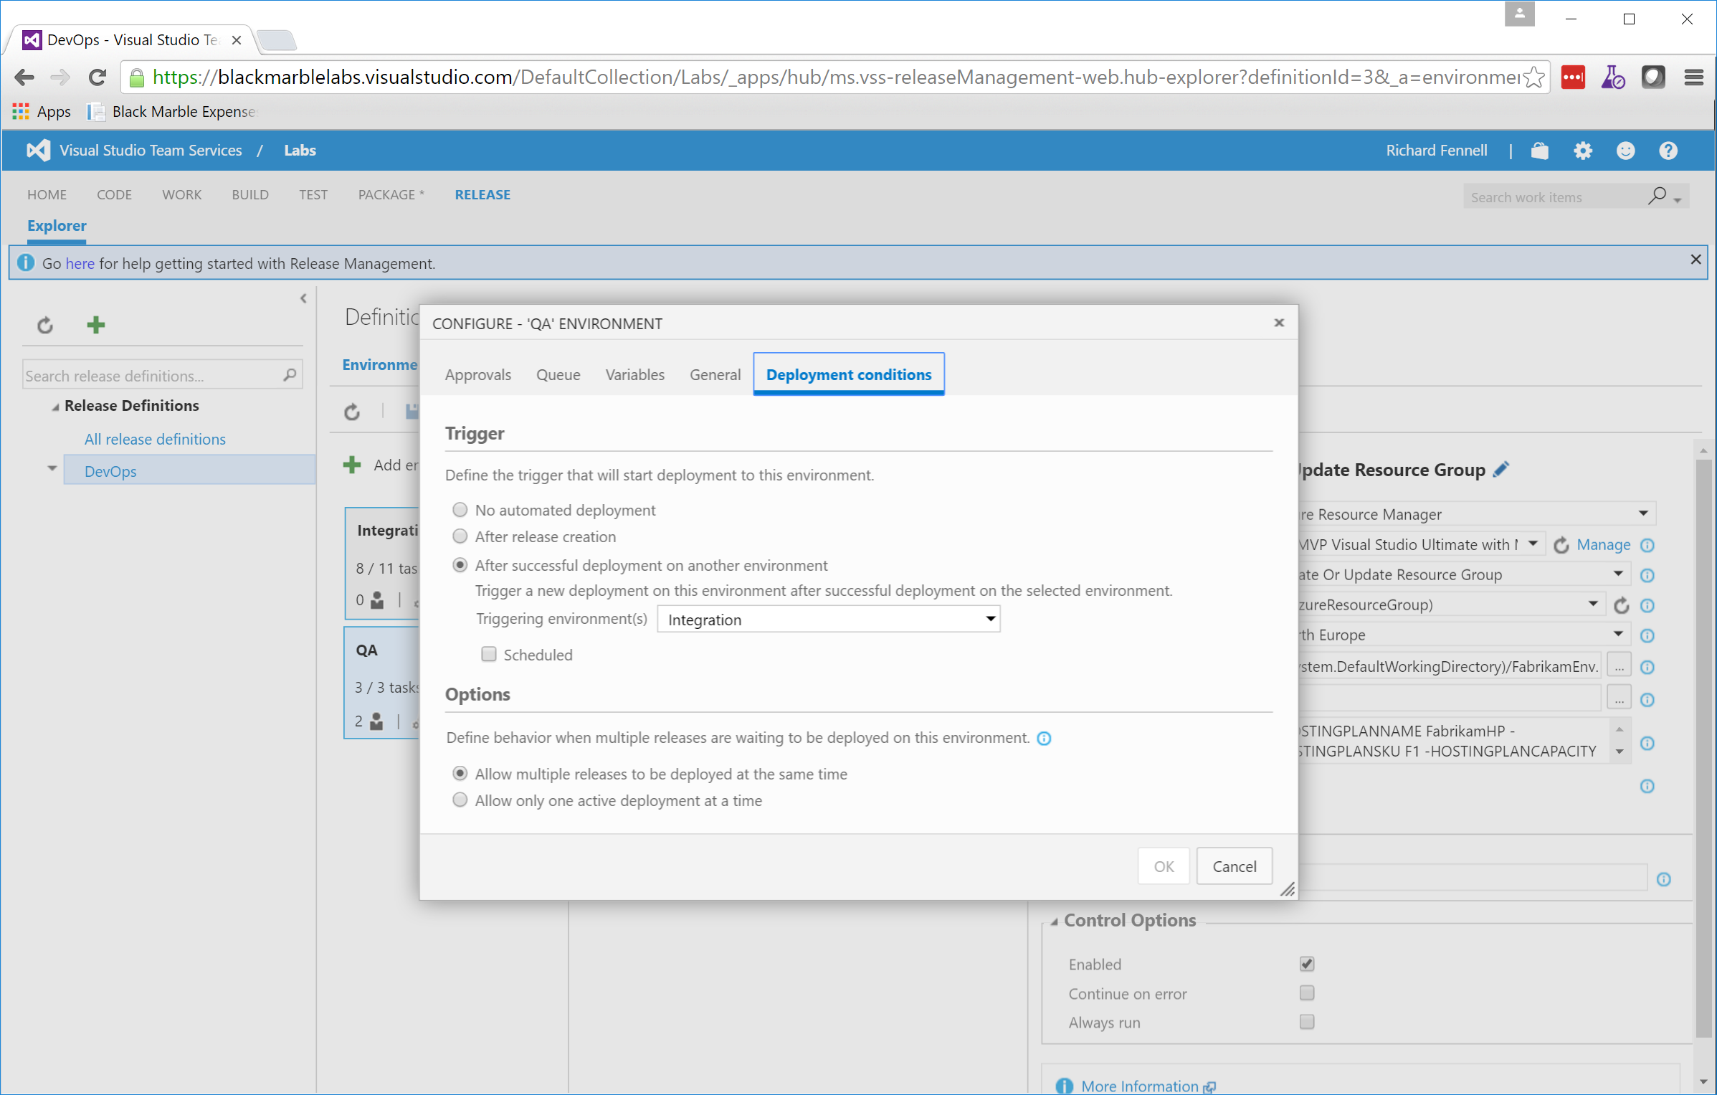
VSTS’s Release System – Conditions

Slide 29
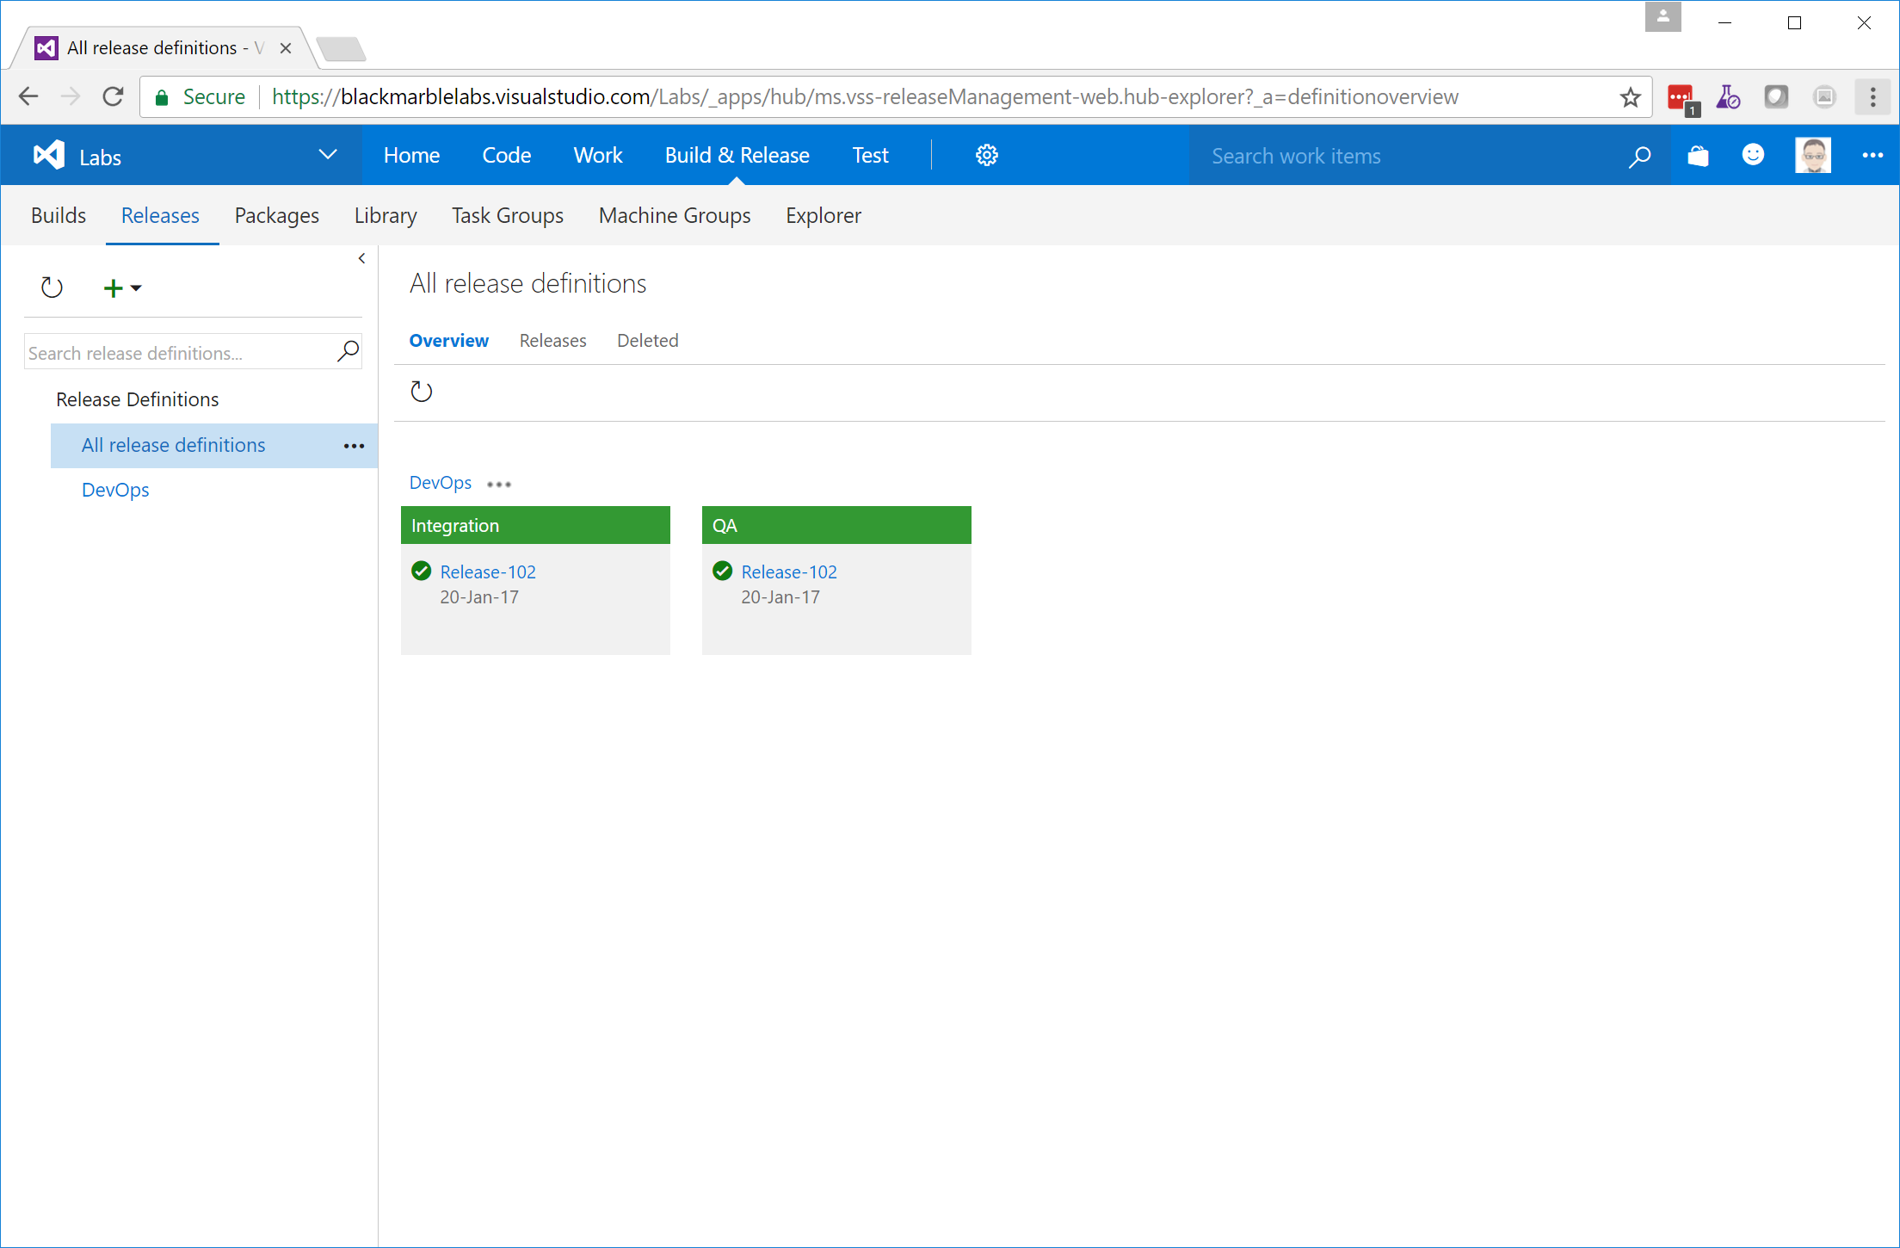
VSTS’s Release System – Overview

Slide 30
And in Summary
Notes:
DevOps is a process not a technology solution
Your steps may differ
No one tool will solve everything
Configuration as code is a key enabler for automation
Essential for cloud; useful for on-prem

Slide 31
Useful Links:
Azure QuickStart Template https://github.com/Azure/azure-quickstart-templates http://azure.microsoft.com/en-us/documentation/templates/
ARM Template Documentation https://msdn.microsoft.com/en-us/library/azure/dn835138.aspx
Azure Resource Explorer https://resources.azure.com/
“Azure Resource Manager DevOps Jumpstart” https://www.microsoftvirtualacademy.com/en-US/training-courses/azure-resource-manager-devops-jump-start-8413

Slide 32
Useful Links:
VSTS Marketplace: https://marketplace.visualstudio.com/vsts http://bit.ly/VSTSBM (Black Marble extensions in marketplace) Our Github Repos: https://github.com/rikhepworth/ https://github.com/rfennell
Our blogs: http://blogs.blackmarble.co.uk

Slide 33

Call to Action
Black Marble DevOps Jump Start (5 days*)
On-site Workshop: Assess your current situation and needs
Technology Demonstrator: Deploy the tools for you to use
Bespoke follow-on: Automate your own projects and build best-practice
*Can be funded through Microsoft DPS if available

